Slide 1
Ontology Driven Data Collection for EuPathDB
Jie Zheng
Center for Bioinformatics
University of Pennsylvania Perelman School of Medicine
2011 ICBO OBI Tutorial

Slide 2
Issues associated with Data Collection
Heterogeneity of free text
Difficulty in data integration, requires human intervention
Complex queries are limited

Slide 3
GenBank Sequence Data

Slide 4
What will be covered in this use case
How to design a data submission form based on an ontology model
Example: Form to collect sequence data and information on isolates of pathogens
How to reduce user effort in submission using restrictions defined in an ontology
Example: Use of the Ontology for Parasite Lifecycle (OPL) in the annotation of Gene Manipulation and Phenotype of Parasites submission form

Slide 5
Ontology Based Model
Data or information for collection
Identify ontology parent classes of data or information
Apply the ontology defined relations to reveal the interconnection of data or information collected
The model will help
Clarify what data or information will be collected
Identify the data or information needed to be collected
Example:
Isolate submission form for EuPathDB
Project with Omar Harb and Chris Stoeckert

Slide 6
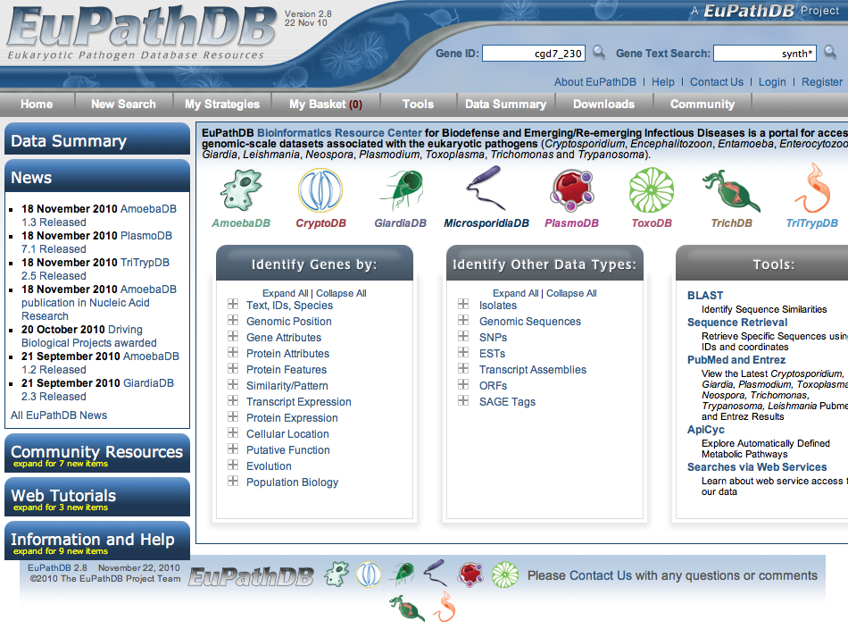
EuPathDB
One of five National Bioinformatics Resources Centers (BRCs) supported by NIH/NIAID, containing protozoan parasite genomic and functional genomic data
Mission is to enable researchers worldwide to identify and prioritize candidate targets for further research in the lab, field and clinic.
EuPathDB: a portal to
eukaryotic pathogen
databases. Aurrecoechea C, et al.
Nucleic Acids Res. 2010

Slide 7
Current Issues of Isolate Data
Need to import and integrate datasets from GenBank
GenBank does not specify needed metadata for isolates
Manual curation required
Harmonize: enable host queries: Human-> Homo sapiens
Deconvolute descriptions in free text: isolated from storm waters, isolated from Homo sapiens patient infected with HIV
Notes:
Completeness of isolate data depending on submitter

Slide 8
Isolate Submission Form
Isolate information
Target isolate information
Geographic location
Source organism samples information
or Environmental samples information
Sequence information
These data are important for parasite epidemiology.

Slide 9
Ontology Based Model
Identify ontology parent classes of data or information
Apply the ontology defined relations to reveal the interconnection of data or information collected

Slide 10
Main Components of OBI and Their Relations
site
is_a independent
_continuant
located in
has specified input
material entity
is_a independent
_continuant
planned process
is_a occurrent
has specified output
inheres in
is about
is about
information content entity (ICE)
quality
is_a dependent_
continuant
is about

Slide 11
Ontology Based Model
ICE
Isolate ID
denotes
Process
ICE
is about
Date Collected
OBI:
Specimen
Creation
Process
site
Geographic Location
(Country, State, etc.)
has_specified_input
Isolate
Environmental
Source
Located_in
qualities of host organism: sex, age, etc.
OBI:
Specimen
(Isolate
Specimen)
has_specified_output
material
entity
Source
has_specified_input
other inputs:
PCR primers
Host
has_specified_input
organism
Isolate Species
has_part
OBI: Assay
(Sequencing
Typed Assay)
other
information:
Subtype, etc
Product Name
denotes
Protein
ICE
dependent
continuant
Nucleotide
Sequence
inheres in
DNA
derives_from
ICE
Sequence
has_specified_output
is about
Notes:
Process central ontology, process will link the material entities

Slide 12
Isolate Submission Form
Support multiple sequences submission to GenBank with a parser
Notes:
Isolate ID: not clear what it refers to
Specimen id
target isolate id
sequence id (which it is in EuPathDB)
Sequence description: (required by GenBank)
complete sequence
partial sequence
partial cds
unknown

Slide 13
Ontology Chosen for Annotation
OBO foundry library ontologies
Interoperable
Easy for integration
Community preferred/well-defined ontologies

Slide 14
Ontology Selection
14
Notes:
Isolate ID: not clear what it refers to
Specimen id
target isolate id
sequence id (which it is in EuPathDB)
Sequence description: (required by GenBank)
complete sequence
partial sequence
partial cds
unknown
14

Slide 15
Reduce User’s Efforts in Submission using Restrictions Defined in Ontology
Limit ontology terms used in annotation based on the restrictions of terms
Example:
Ontology for Parasite Lifecycle (OPL) used in the annotation of Gene Manipulation and Phenotype Data
Project with Omar Harb and Chris Stoeckert

Slide 16
Genetic Manipulation and Phenotype Submission Form
Genetic Manipulation
Mutation method including selective marker, report if available
Mutation type (effect on gene function)
Phenotype data – impact of genetic manipulation on four possible observed features:
Quality of the organism
Cellular location of gene product
Molecular function of gene product
Biological process of gene product

Slide 17
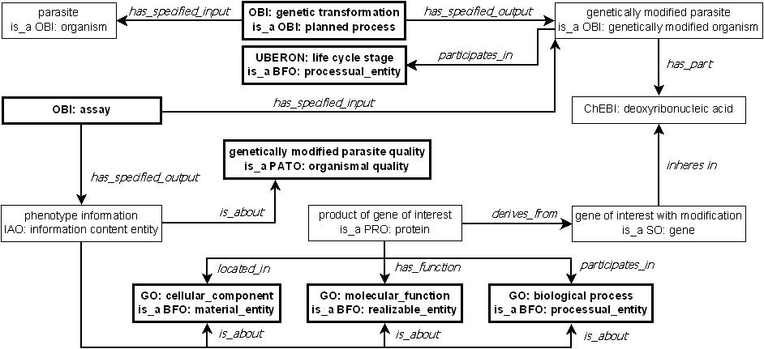
Ontology-based Representation of Genetic Manipulation with Resulting Phenotype Data
Use OPL for annotation
The data collected in the submission form are in the bold font.
The fields require ontology terms are in thick border box.
Ontology for Parasite Lifecycle (OPL) will be used in the annotation of life cycle stage

Slide 18
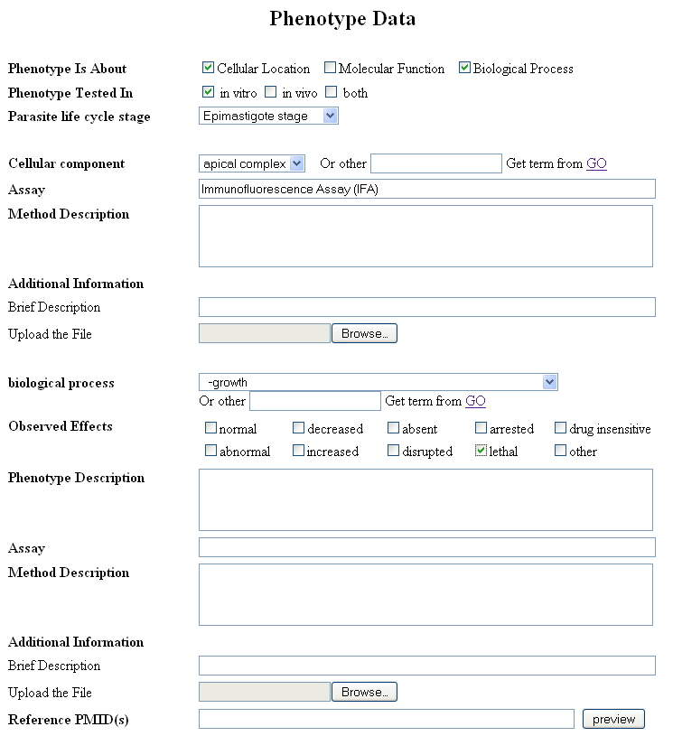
Phenotype Section
Ontology for Parasite Lifecycle (OPL)
Cellular location
GO
OBI
Will link to
Evidence Code
Biological process
GO
PATO
OBI
Notes:
Would like to linkEvidence code to OBI assay
Question:
What relation should use to link the quality
(PATO: organismal quality) such as:
PATO: lethal to biological process such as
GO: growth
We think would be great. One barrier we've run into that could be an issue here, is the range and domain of using qualities as defined though BFO and RO. I don't think they can currently be applied to processes and functions. We would love to see a solution and make use of it.

Slide 19
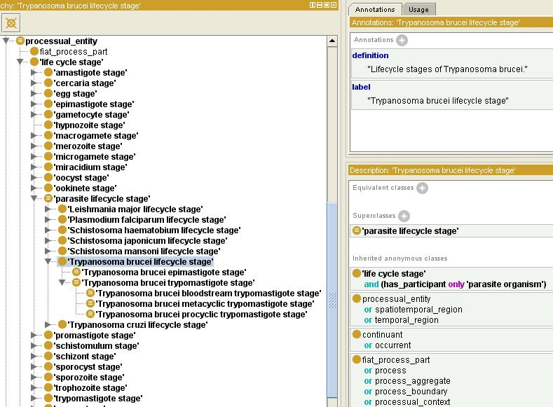
OPL: Priti Parikh, Flora Logan, Kitsos Louis, Satya Sahoo, Chris Stoeckert, Pantelis Topalis, Jie Zheng, Amit Sheth
Notes:
Around 300 terms, parasite lifecycle stage, where it takes place, vector and host of specific parasite, etc.

Slide 20
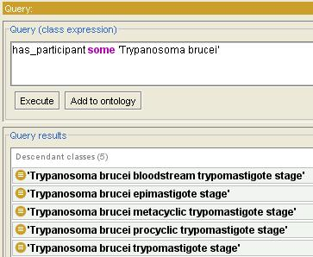
Lifecycle Stages for a Specific Parasite
Over 100 terms -> 5 terms

Slide 21
Summary – lessons from this use case
How to design a data collection form based on an ontology model
How to choose ontologies to be used for annotations collected in the forms
Notes:
EupathDB, data we want to collect and issues we have now

Slide 22
Questions?

